Slide 1

M1 - Pair Programming
Participate! The more engagement the better! You are NEVER interrupting me!

Slide 2
Agenda
Static Keyword Build epic burger stuff
Pair programming

Slide 3

Static keyword ahead
AVOID STATIC except in fairly rare cases.
DO NOT let IntelliJ tell you you need to create static variables and methods!

Slide 4
static variables
Static members belong to the class. Instance members belong to an instance of the class. Static methods can be invoked without creating an instance of the class. Static variables and methods cannot be accessed with the this keyword, since they are not part of the object.
private static int x = 10;
int y = x + 5;
int y = this.x + 5; ← this keyword this cannot be used with static
Since static variables belong to the class and not the object changes to the value from one object can be seen from all objects.

Slide 5

Whack a mole example (normal - no static)
Bob
Sally
Samantha
Bob Whacked: 2
Sally Whacked: 1
Samantha Whacked:1
public class WhackAMole
private int count = 0
public void increment() { count++;
}
public int getCount() {
return count;
}
NOT using static variable/methods (each instance has its own variable value)

Slide 6
Whack a mole example using static (avoid unless you know what you are doing)
Bob
Sally
Samantha
Bob Whacked: 1
Sally Whacked:1
Samantha Whacked: 1
public class WhackAMole
public static int count =0
public static void increment() { count++;
}
public static int getCount() {
return count;
}
Using static variable/methods (usually BAD) Each instance shares the variable data value

Slide 7
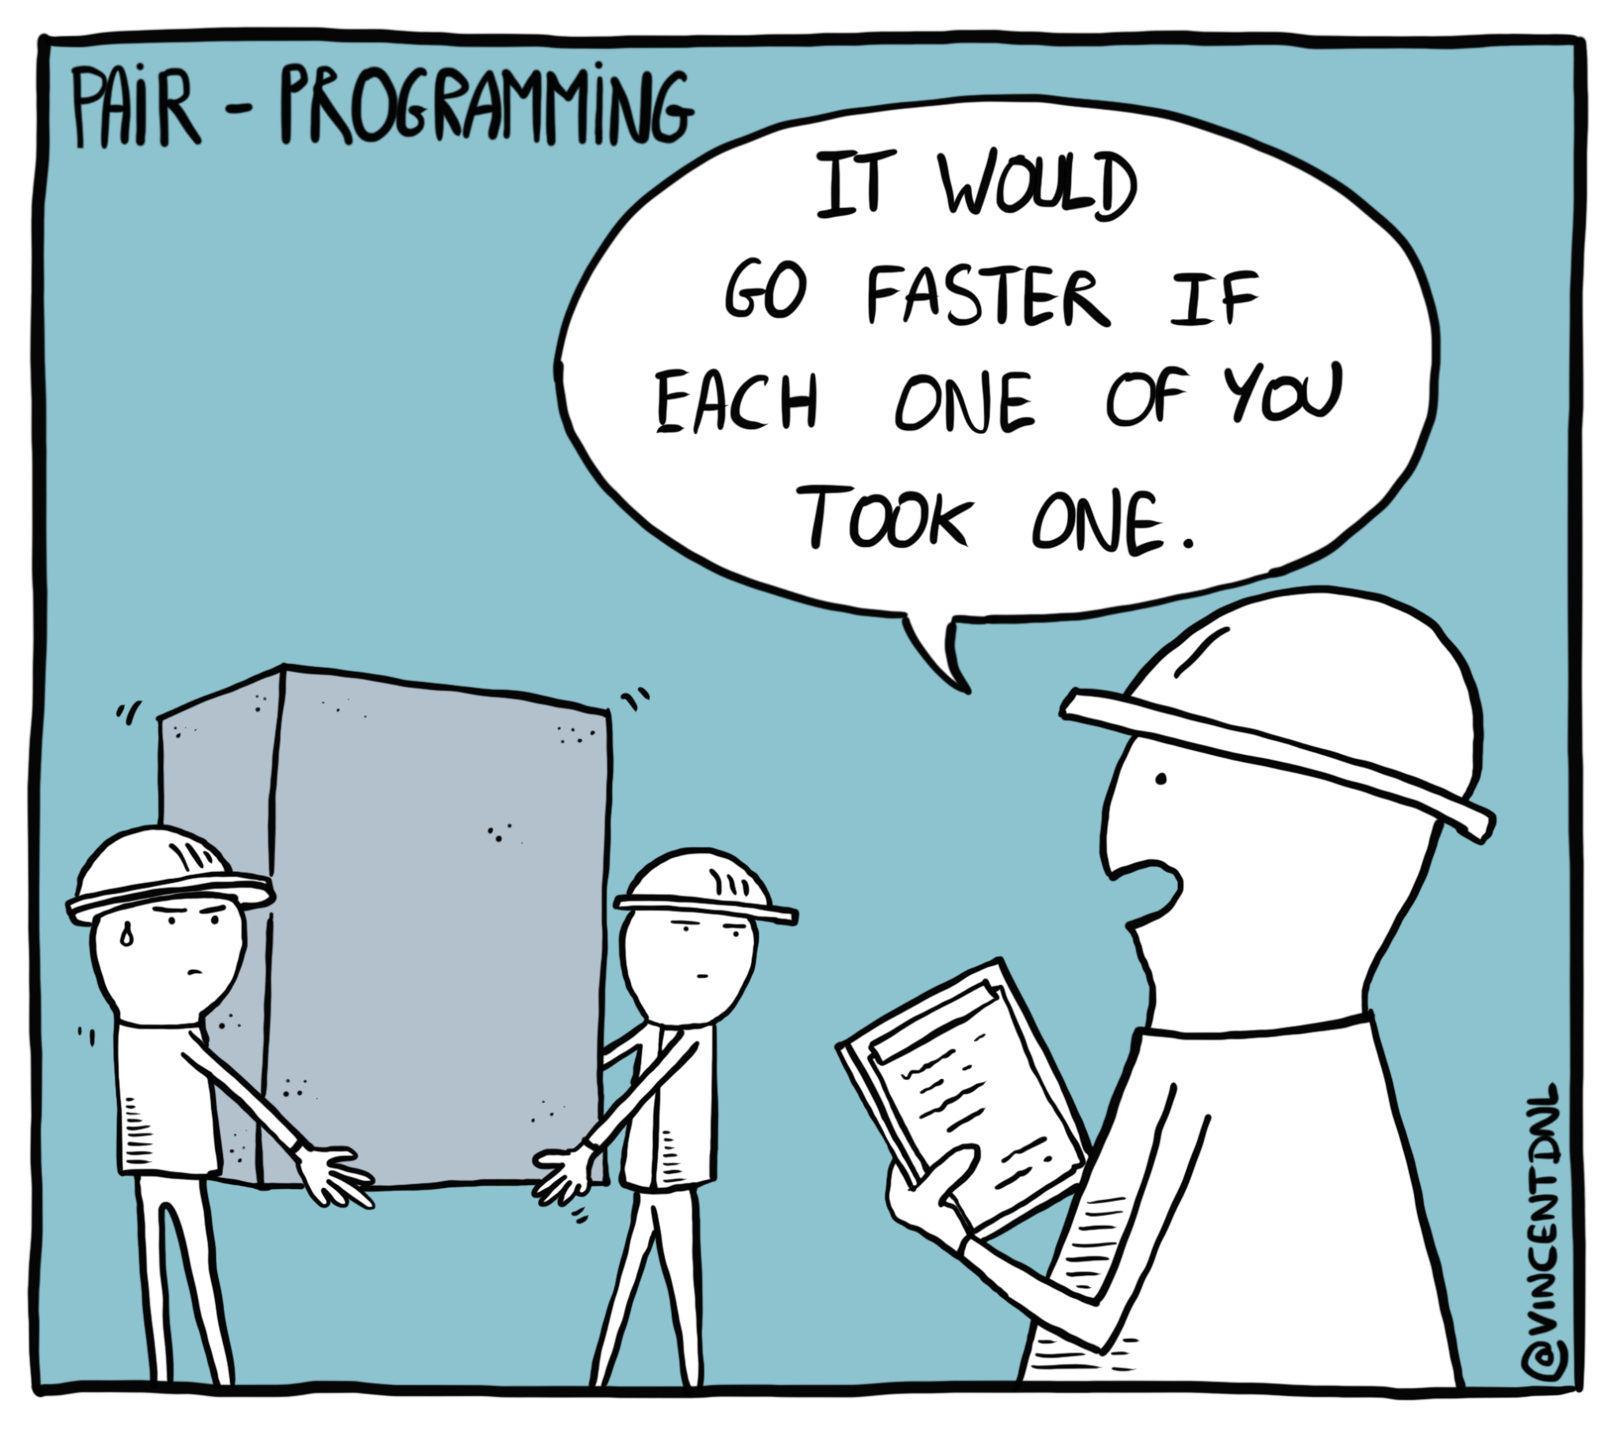
Pair Programming

Slide 8
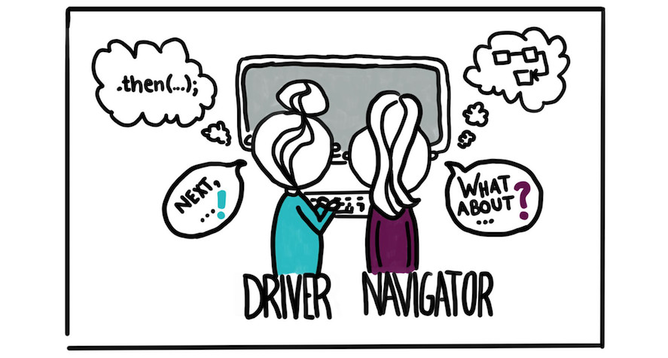
Pair Programming
Definition: a practice in which two programmers work side-by-side at one computer, continuously collaborating on the same design, algorithm, code, or test. This method has been demonstrated to improve productivity and the quality of software products.
Driver - writes code, but does not come up with ideas
Navigator - comes up with ideas, but does not write code

Slide 9
Rules of Pair Programming
Paraphrased from the article: Everything I Needed to Pair Program, I Learned in Kindergarten - 1999 Laurie Williams and Robert Kessler

Slide 10
Share
Both programmers own everything.

Slide 11
Play Fair
Take turns driving (writing the code) and navigating (continually reviewing)
Set a limit (time, lines of code, problems, etc) and switch on time.

Slide 12
Clean Up
Defects and problems belong to the pair
Work together to solve issues
It is never your partner’s fault - if you both did it together, so you own the blame. fix it together

Slide 13
Hold hands and Stay Together
ALL work must be done together, no exceptions
It is not a competition - it is 2 programmers working together to solve a singular task
If you partner needs a break, then you take a break

Slide 14
Say You’re Sorry
Practice ego-less programming
Don’t insist on it being your way, even if you think it is better
Don’t get defensive
Don’t be aggressive

Slide 15
Common Problems
Pairs are at different skill levels
One partner taking control
One partner sitting back and not contributing
Scheduling and reliability
Lack of communication about expectations

Slide 16
Violations of Pair Programming
Taking turns doing the assignment (you do today’s, I will do tomorrow)
Splitting the assignment and each doing half
Working on the assignment without your pair partner
One partner rewriting code you worked on together
Coming to ask an instructor for help without your partner

Slide 17
Git
Never clone a new repository inside another. Put pair projects in a pairs folder
git clone “the url you copied from gitlab for your pair repo”

Slide 18
How to work on a shared repo
GitLab Repo
(origin)
Person 2 (Navigator) - No coding then takes over
1.
Person 1 (Driver) codes
2.
pushes
pulls
git add -A
git commit -m “..”
git push origin main
git add -A
git commit -m “..”
git pull origin main
pulls
pushes
3.
Person 2 (takes over as Driver and codes awhile… then)
Person 2 (Navigator)
4.
git add -A
git commit -m “..”
git push origin main
git add -A
git commit -m “..”
git pull origin main
If you are the navigator, DO NOT touch any project files. A changed timestamp will cause a merge conflict.

